Slide 1


SDN using Docker
Kunj Amrutbhai Patel

Slide 2
Docker Fundamentals Docker Networking With Open vSwitch
OpenDaylight (ODL) in Docker
Docker – Wireshark
Challenges Encountered
Future Work
Agenda

Slide 3
Docker Fundamentals
Why Docker?
What is a Docker?
What are the Docker Components?

Slide 4
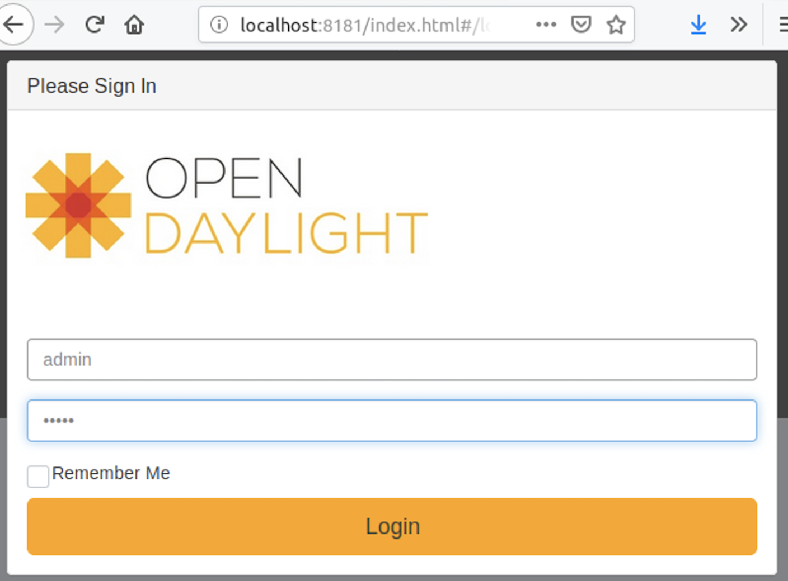
OpenDaylight:
OpenDaylight (ODL) is a modular open platform that can be used to customize and automate networks of any size and scale. In this project, we will run OpenDaylight from Docker.

Slide 5
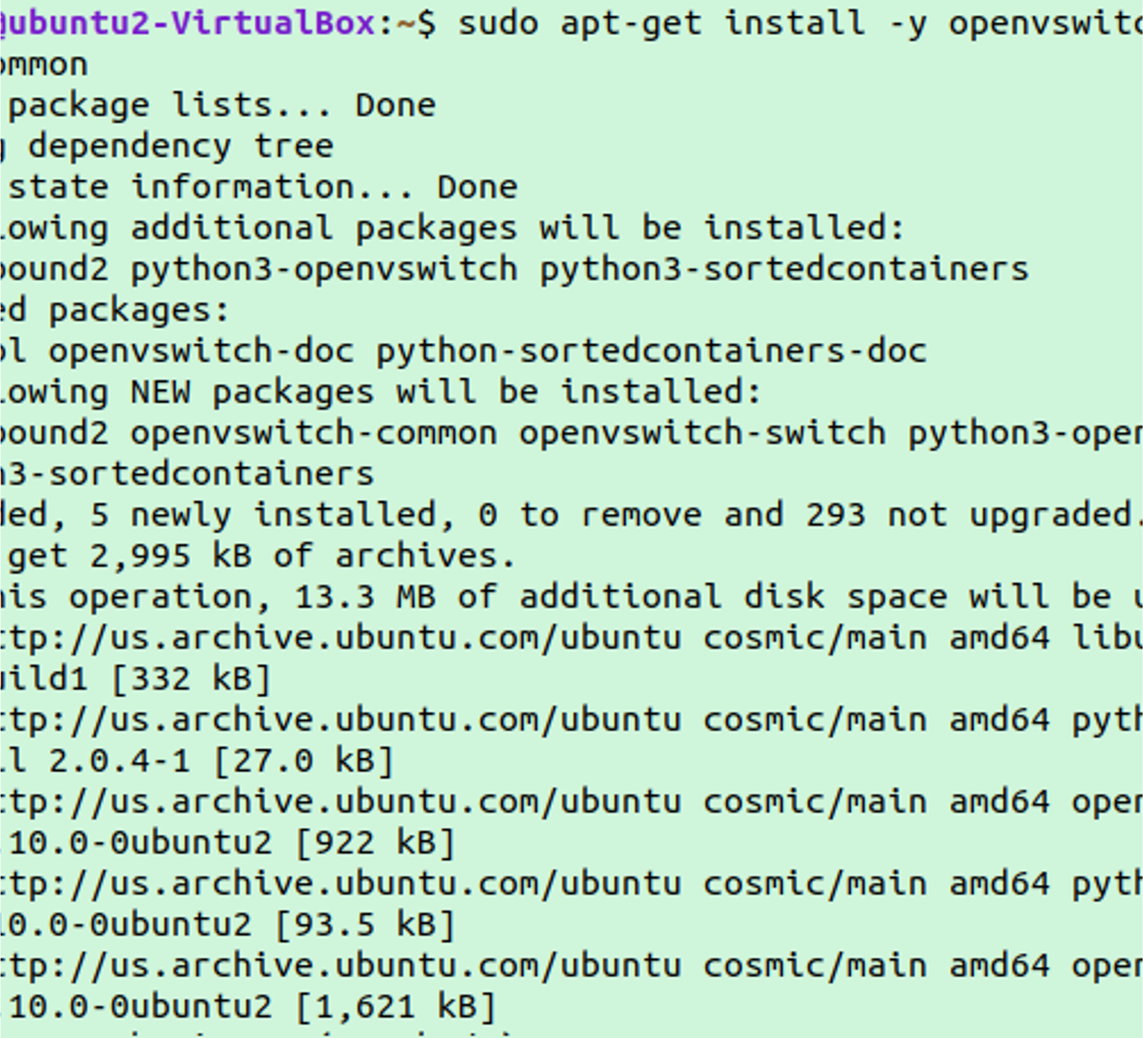
OpenvSwitch
Open vSwitch is an open-source distributed virtual multilayer switch implementation. We will implement "Multi-Host Overlay Networking with Open vSwitch Using Dockers" in this project.

Slide 6
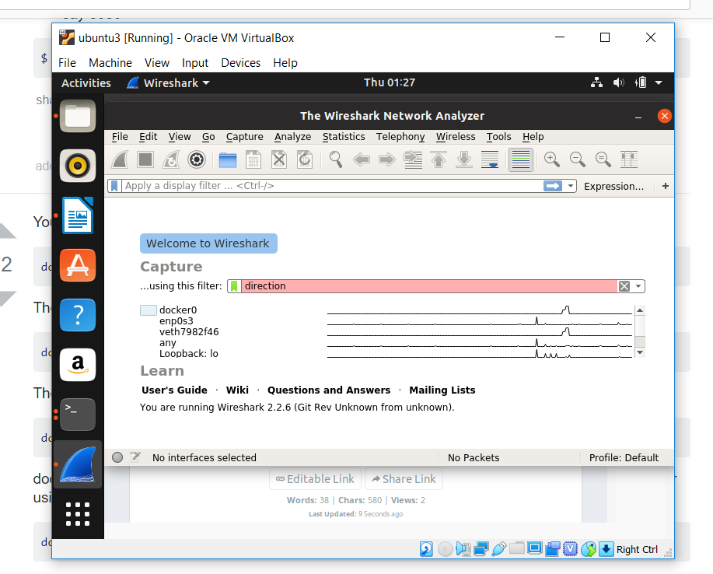
WireShark
Wireshark is an open-source packet analyzer that is free to use. It is used for network troubleshooting, research, the creation of software and communications protocols, and education. In this project, we're using Docker to implement WireShark and analyze packets.

Slide 7
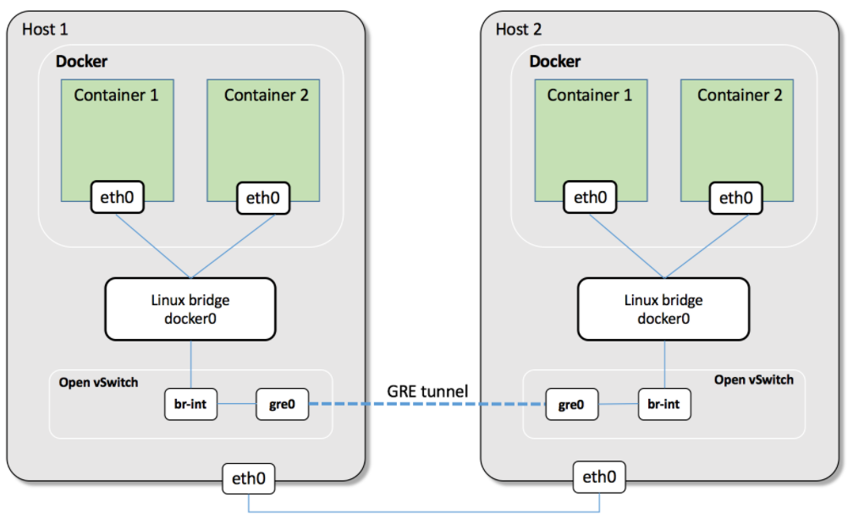
Architecture: Docker Networking With Open vSwitch

Slide 8
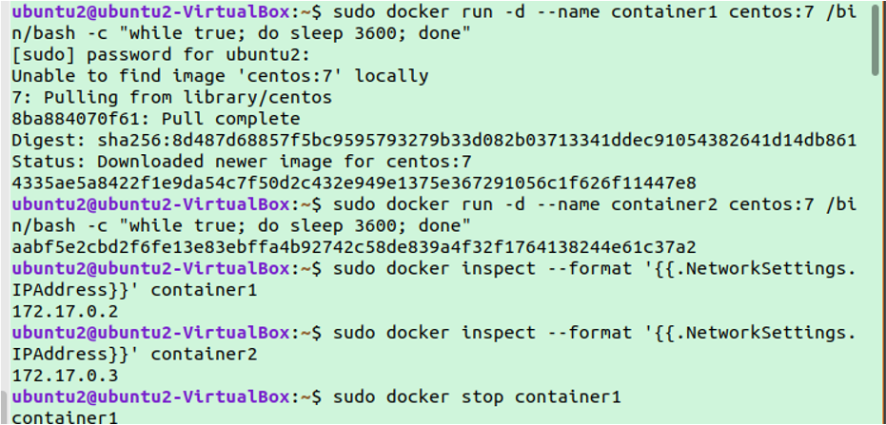
Output
HOST-1

Slide 9
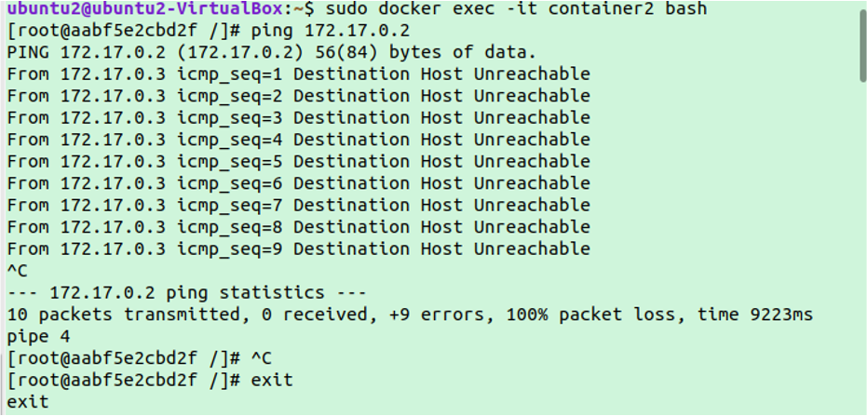

Slide 10
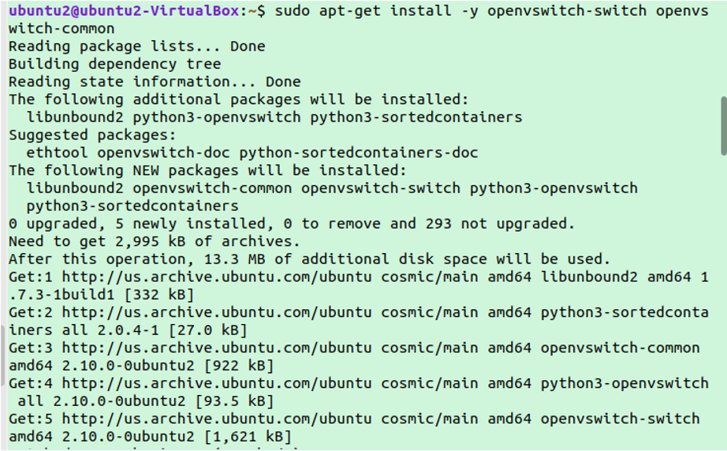

Slide 11
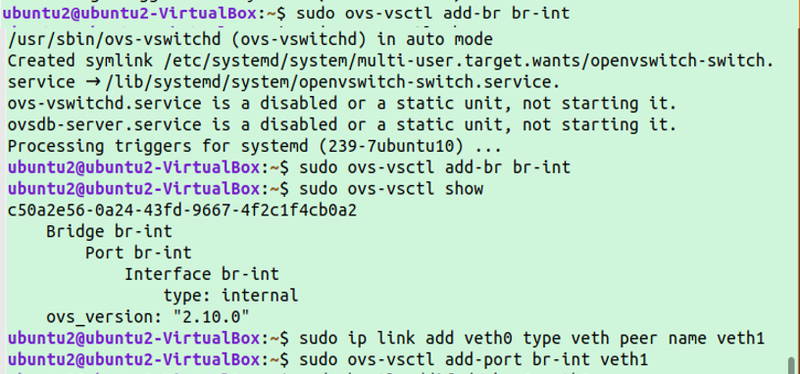

Slide 12
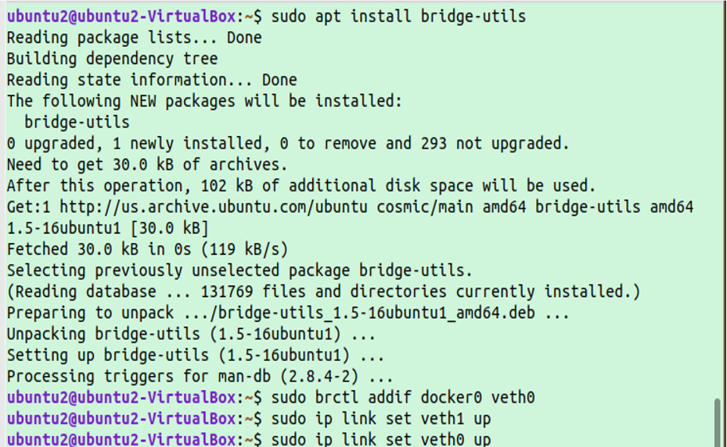

Slide 13
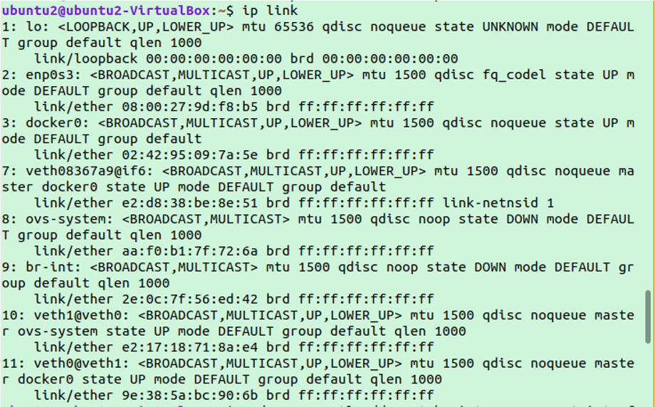

Slide 14
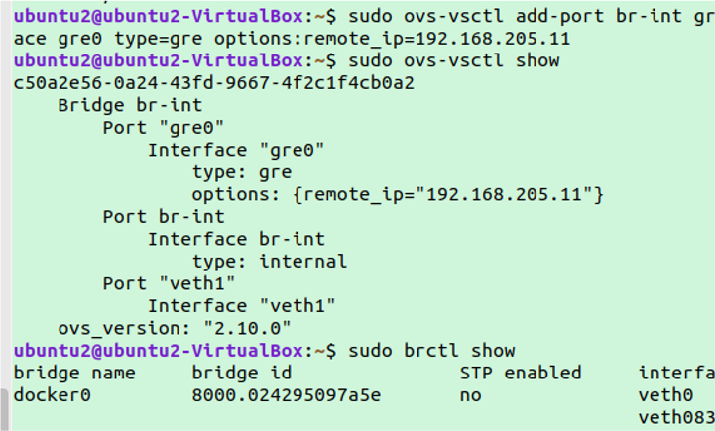

Slide 15
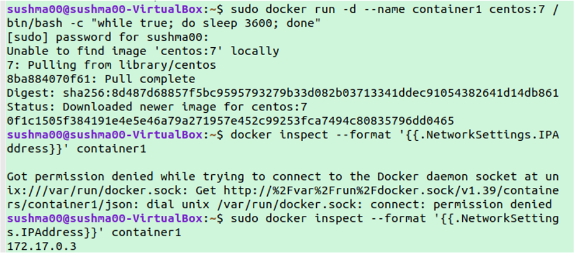
HOST-2

Slide 16
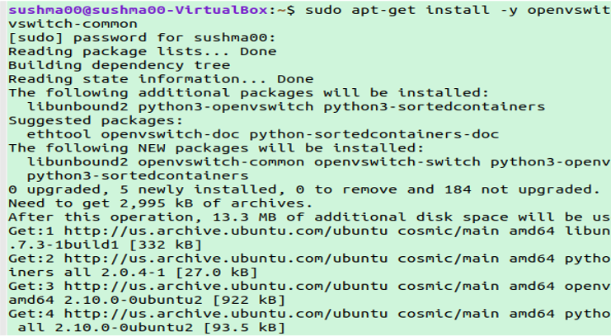

Slide 17
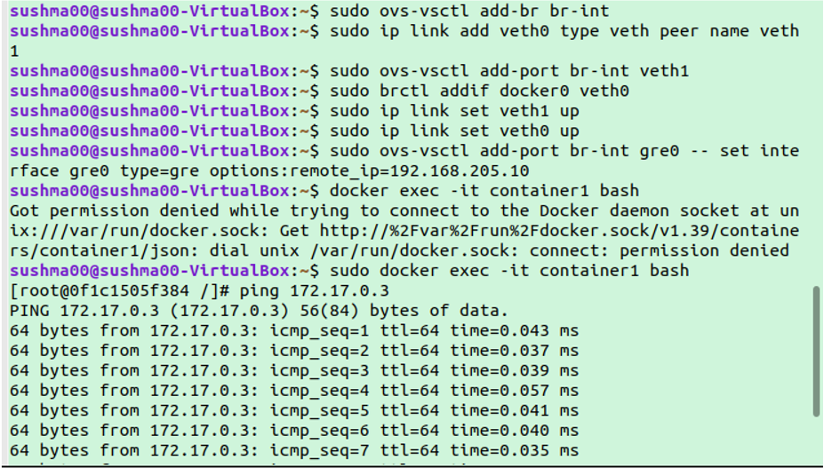

Slide 19
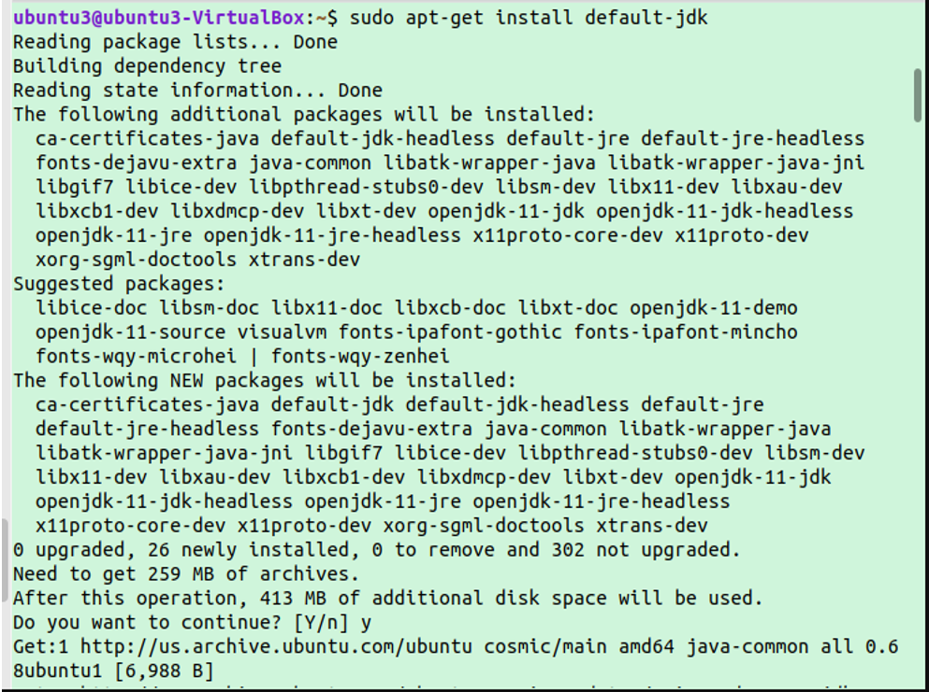
Opendaylight in Docker

Slide 21
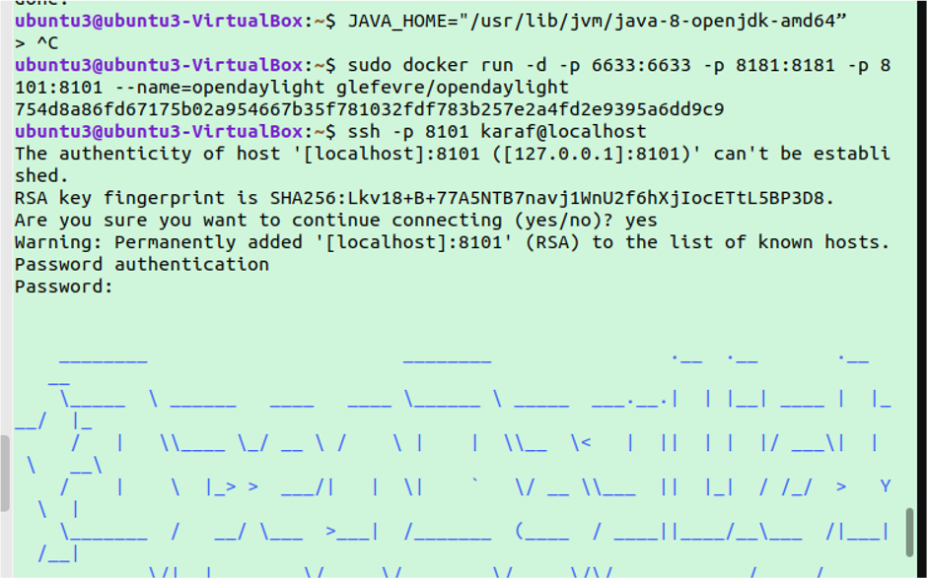

Slide 22
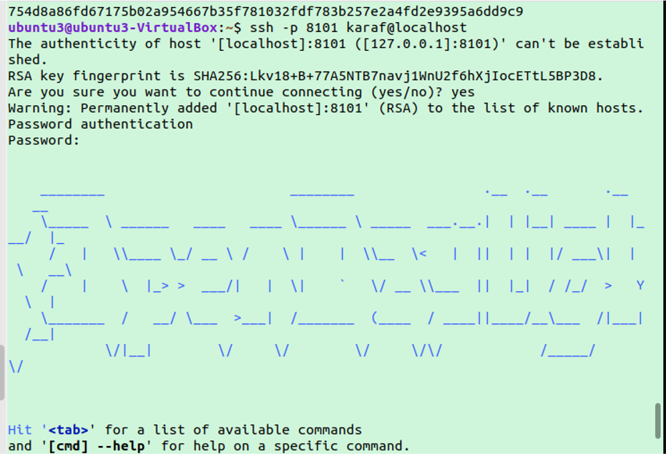

Slide 23
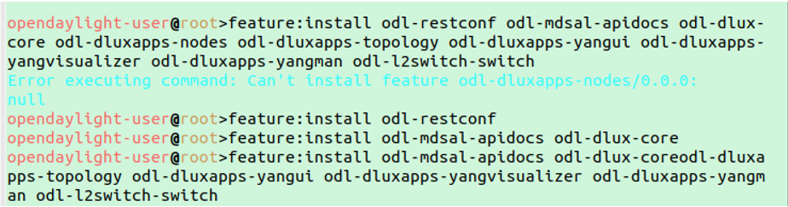
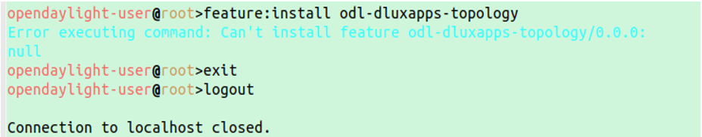

Slide 24
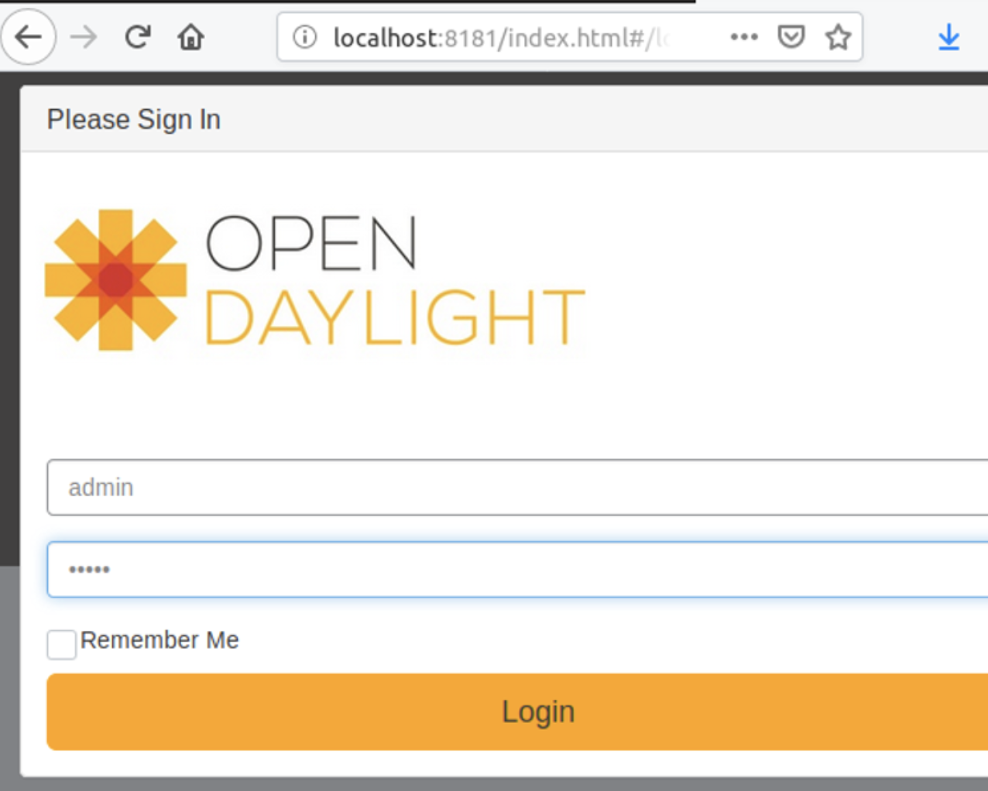
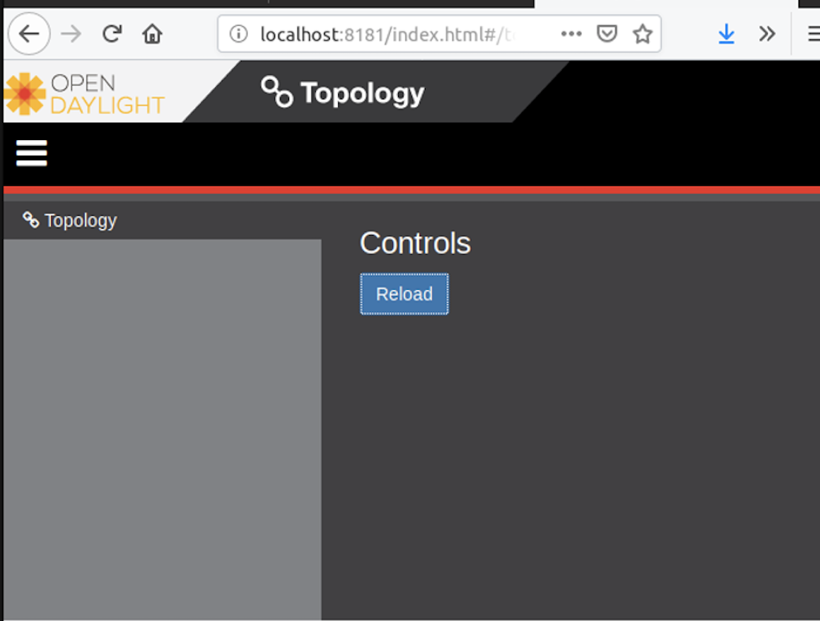

Slide 25
Wireshark in Docker

Slide 27
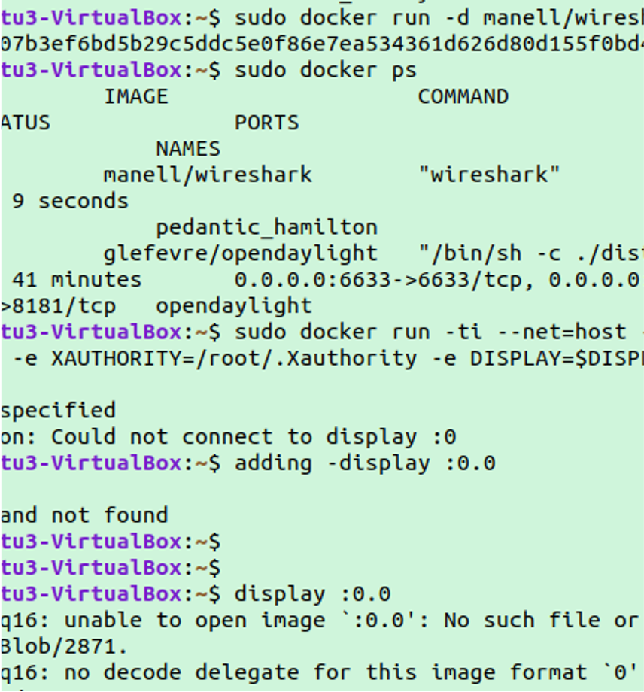
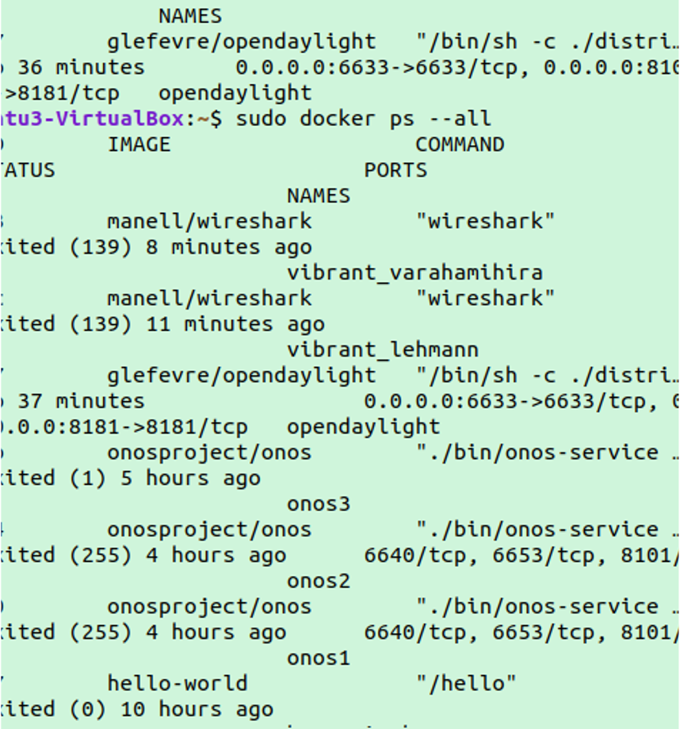

Slide 28
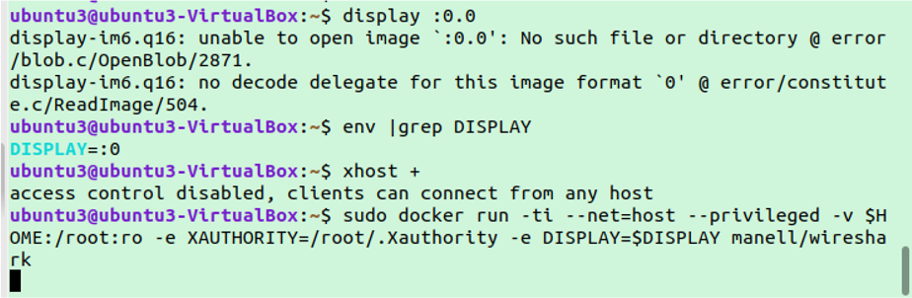

Slide 29
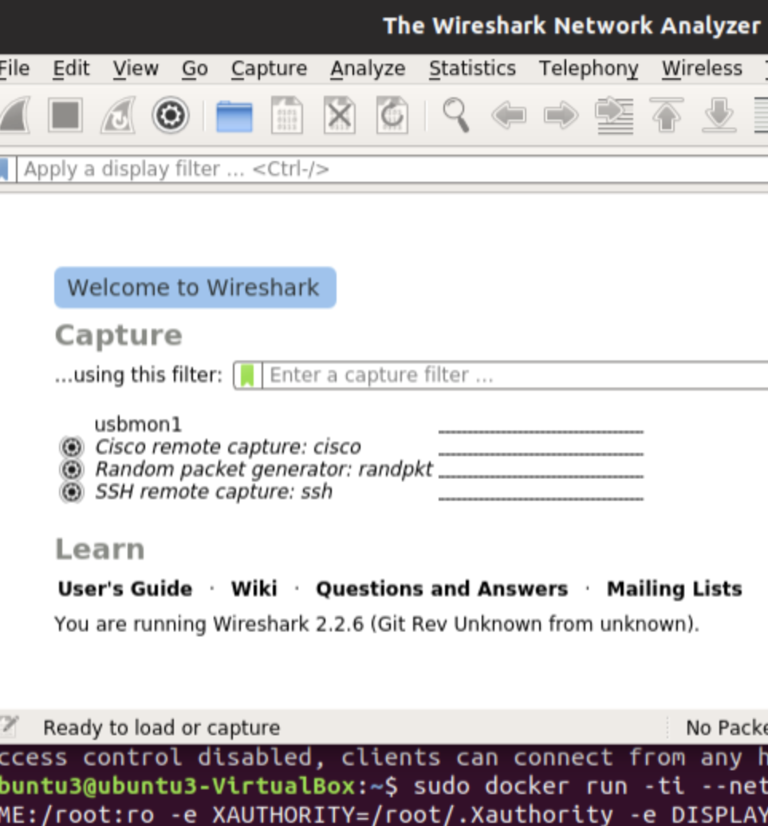
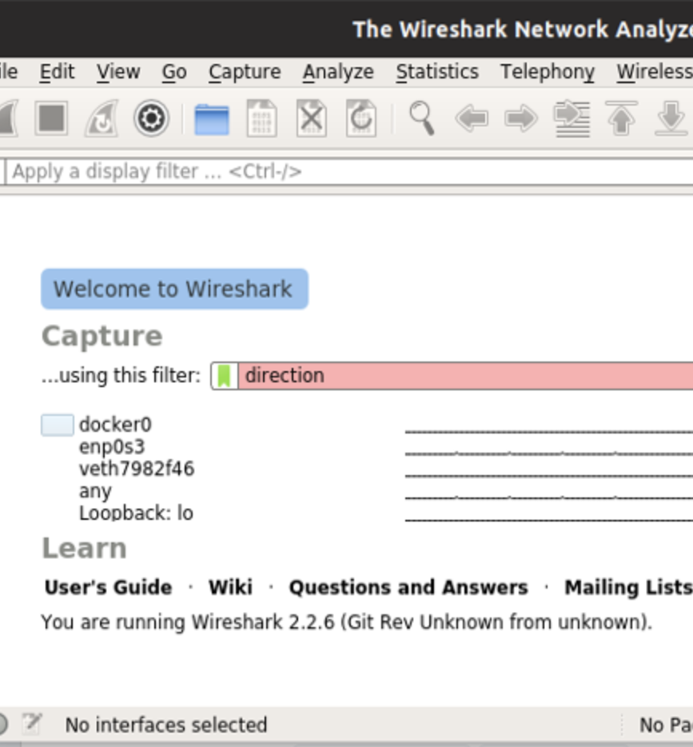

Slide 30
CHALLENGES FACED
Comprehending SDN with Docker
Because of dependency problems, OpenDaylight was installed on docker.
Setting up a tunnel link between two hosts.

Slide 31
Future Work
Create a new docker network instead of using default docker0 bridge.
Configure cluster of opendaylight instances where each hosted on docker containers.
With the increase in the requirements for a project, dockers will be of paramount important.
In this project we tried to implement and launch SDN based controller, switches and analyzers using dockers.
Containerization using Dockers will be more useful in a practical team based environment.

